Slide 1


Web Technology Project – Amazon Clone
Group number – 1
Karan Sajeeth (105) (0120190150)
Himanshu Sengar (107) (0120190148)
Abhisek Nayak (100) (0120190159)
Shantanu Kadam (102) (0120190155)

Slide 2
Index
Introduction
Features of the website
Objective
Technology stack
Components added
Modules and services used
Result
Conclusion
References

Slide 3
Introduction
Our project implements the simple working of an ecommerce website like Amazon and Flipkart.
The home page will have a navbar for searching products, categories, login and signup component and products.
User can login or register himself in the respective pages and his data will be stored in the database.
Once customer entered with his own username and password, at that time automatically he will be logged in and once user selects an item, it will be added to cart.

Slide 4
Introduction
5. In case user thinks the selected item is not useful, then he can delete that item from the cart.
6. The cart will display the added products, its quantity and total price to be paid by the user.

Slide 5
Features of the website
Home page with product categories
Search bar
Working Login/Signup page
Shopping cart section
Payment section

Slide 6
Objective
Create user-friendly interface of website like Amazon.
To show working of product services, api and login.
Validate user information of user through database.
To demonstrate order & payment process of a product.

Slide 7
Technology stack
Angular – Frontend
NodeJS & Express – Backend
Bootstrap & Font awesome – Design
RestAPI, JWT & Fake store api
Mongo Atlas – Database
VS Code editor

Slide 8
Components added
Header – It contains the home page with carousel of products and categories.
Cart – Products added to the cart and their details.
Login – Login page for old user.
Registration – Registration page for new user.
Payment – Transaction of the product purchased.

Slide 9
Modules & services used
Forms Module - It allows you to isolate and work with a specific form on a HTML page.
Ngb Module - It declares which components, directives, and pipes belong to the module.
Browser Module - It provides services that are essential to launch and run a browser application.
HTTP Client Module - It is a service module provided by Angular that allows us to perform HTTP requests and easily manipulate those requests and their responses.
RestAPI service - It uses HTTP requests to access and use data. That data can be used to GET, PUT, POST and DELETE data types.
Data service - They focus on presenting data and delegate data access to a service.
Auth Guard service - It decides whether the user has access/permission to view specific page / route / path in the application or not.

Slide 10
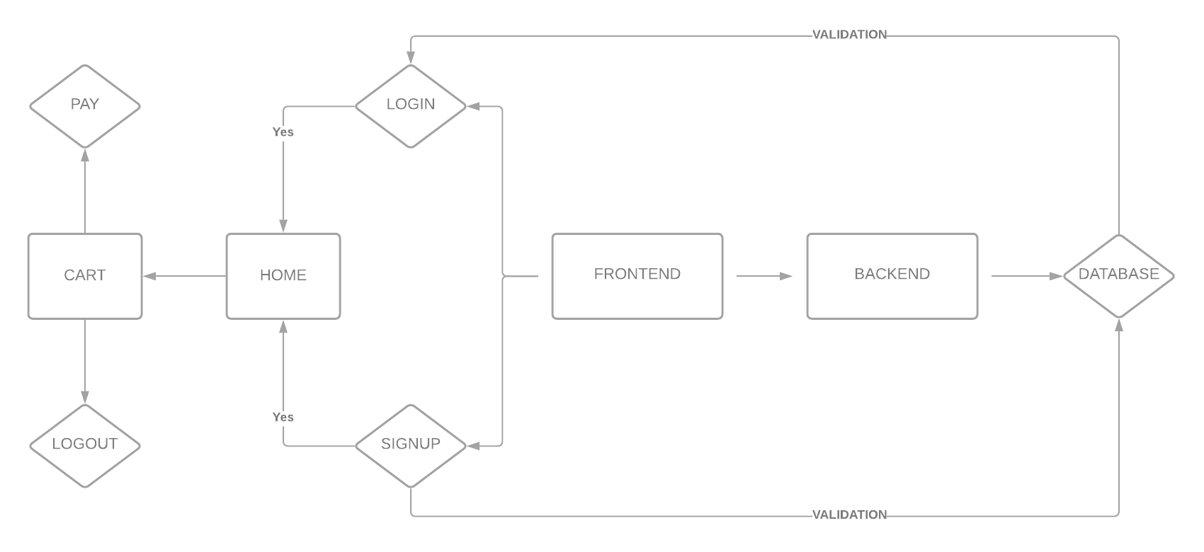
ER Diagram

Slide 11
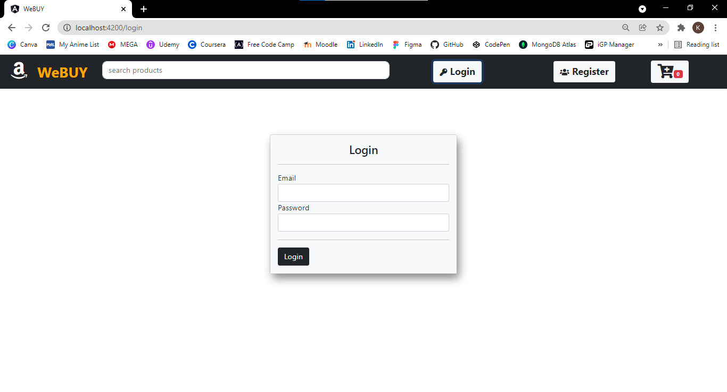
Results
Customer login page

Slide 12
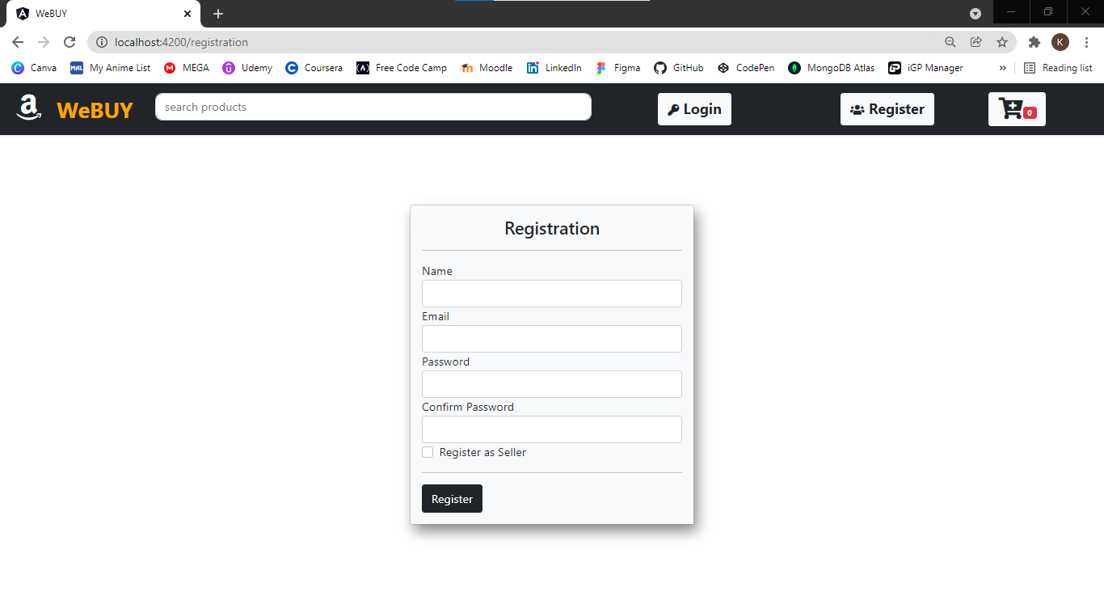
2. Customer registration page

Slide 13
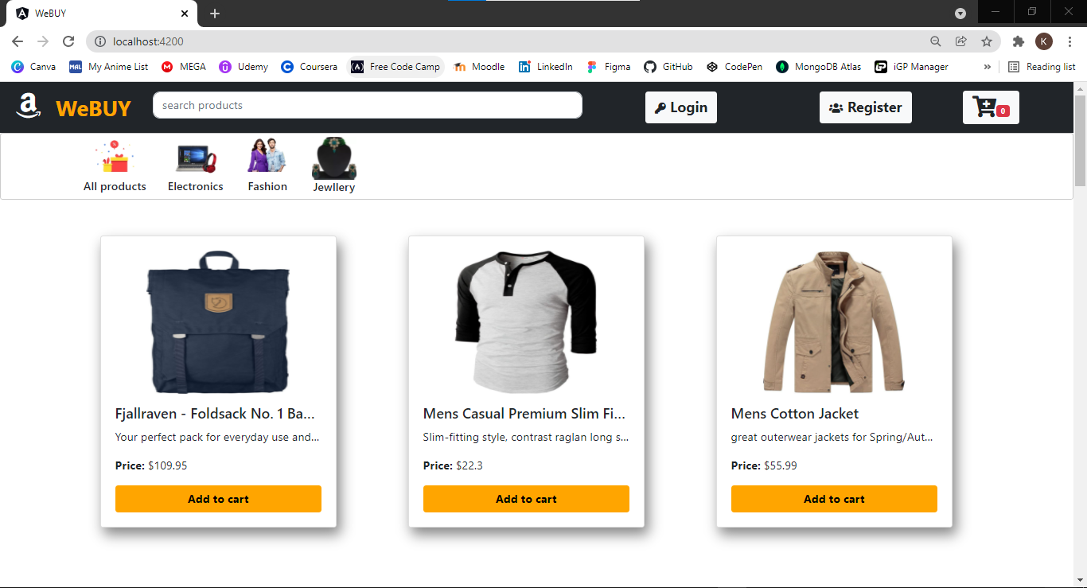
3. Home page

Slide 14
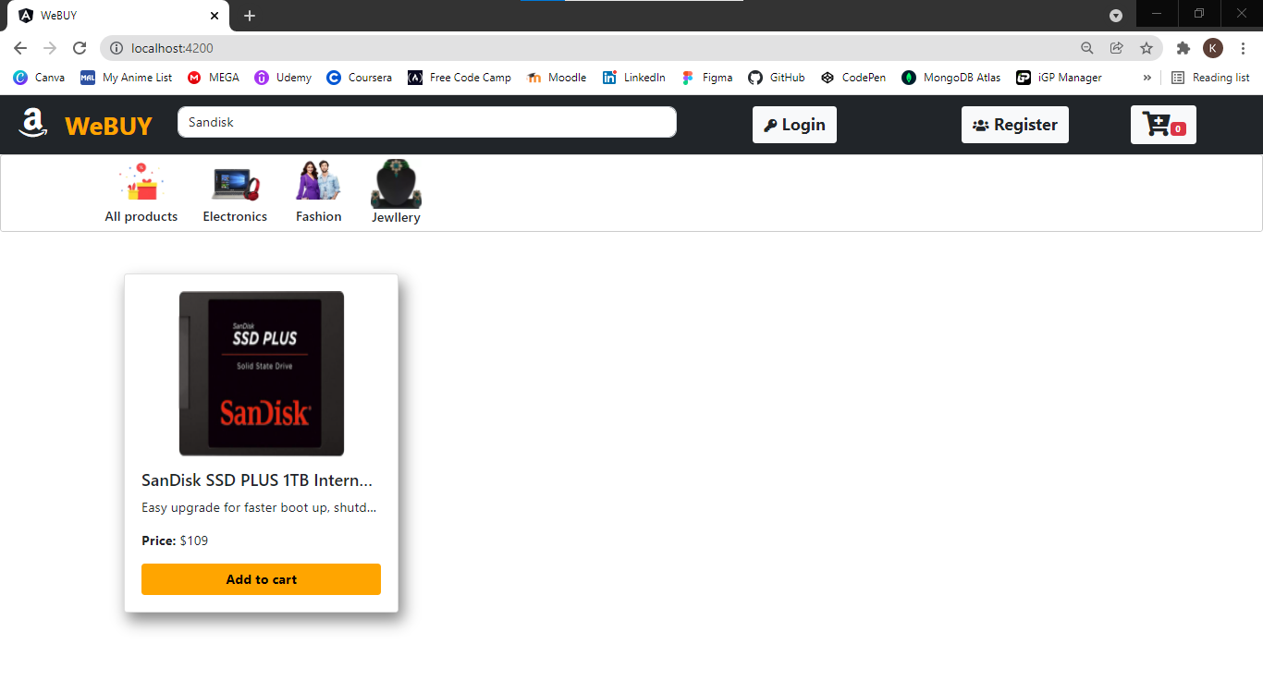
4. Product search page

Slide 15
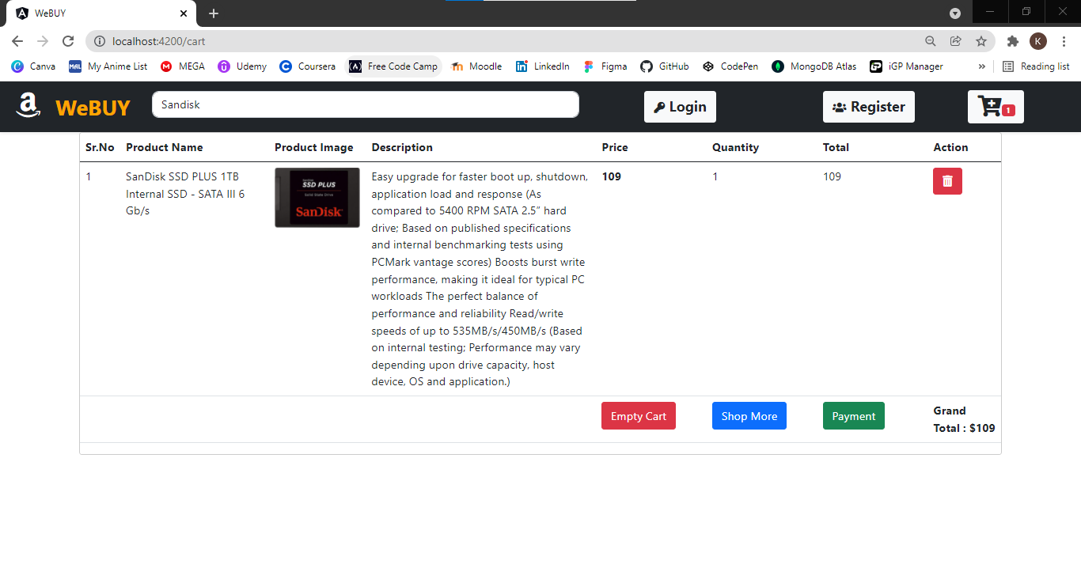
5. Cart page before checkout

Slide 16
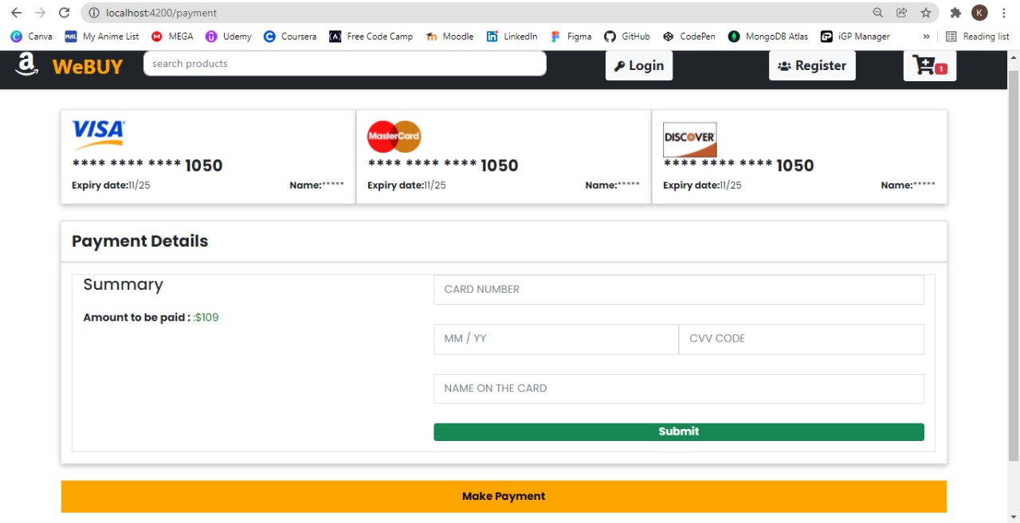
6. Payment interface page

Slide 17
CONCLUSION
Overall in the project, we have understood the MEAN stack workflow and implementation. Building a website like Amazon requires a lot of data and coding skills but a simple website as ours can be done with the understanding of angular, node and mongo db. Thus we would like to conclude by saying that we have understood the mean stack process for creating an ecommerce website and successfully implemented the project.

Slide 18
References
https://www.udemy.com/share/101Jxa3@1oQQLb4qL2UszUy9HrkndbPGZVWsWiDfR7P 9vOtOxbhCNPW4LHc5ceBFP9mxsxwd4Q==/
https://www.positronx.io/mean-stack-tutorial-angular-7-crud-bootstrap/
https://youtu.be/0D5EEKH97NA
https://youtu.be/uvW3C2fmFGY
https://steemit.com/utopian-io/@gotgame/tutorial-1-building-an-ecommerce-applicationwith-the-mean-stack
https://fakestoreapi.com/products/

